Slide 1
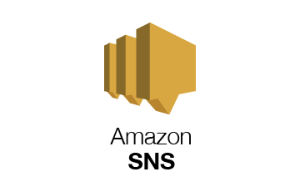

Slide 2

Topics
What is Amazon SNS
What is a Topic
SNS benefits
SNS and SQS

Slide 3

What is Amazon SNS?
Amazon SNS or Simple Notification Service is a web service that makes it easy to setup, operate and send notifications from the cloud.
It provides developers with a highly scalable, flexible and cost effective capability to publish messages from an application and immediately deliver them to subscribers or to other applications.
Push notifications you can do these to Apple, Google, Fire OS and Windows devices as well as Android devices.
Besides pushing a cloud notifications directly to mobile devices SNS can also deliver notifications by SMS text messages or email to Amazon SQS or to any HTTP endpoints.

Slide 4
What is a Topic?
SNS allows you to group multiple recipients using topics. A topic is basically an access point for dynamically subscribe for identical copies of the same notification.
One topic can support deliveries to multiple endpoint types for example you can group together iOS, Android and SMS recipients.
When you publish once to a topic SNS delivers appropriately formatted copies of your message to each subscriber

Slide 5
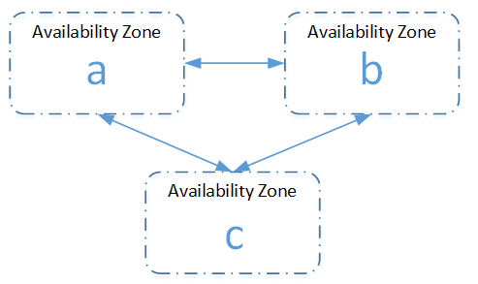
SNS Availability
To prevent messages from being lost all messages published to SNS are stored redundantly across multiple Availability Zones.

Slide 6
SNS benefits
Instantaneous push-based delivery (no polling).
Simple APIs and easy integration with applications.
Flexible message delivery over multiple transport protocols.
Inexpensive, pay-as-you-go model with no upfront costs.
Web-based AWS management console offers the simplicity of point and click interface.

Slide 7
SNS and SQS
Both messaging systems in AWS
SNS push (you push in the messages)
SQS - pull based.

Slide 8
Thank you

